Slide 1
ICT - Week 2

Slide 2
Topics
How Computers Process Data.
Types of Computer
Parts Of Computer

Slide 3
How computer process data ?
Two components handle processing in a computer.
CPU
Memory Unit

Slide 4
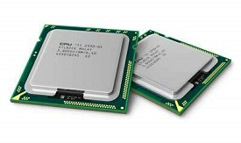
CPU ( Central processing unit )
Every CPU has at least two basic parts. 1. Control Unit - Manages CPU’s Resouces
2. Arithmetic Logic Unit - Performs all the arithmetic operations such as addition subtraction etc.

Slide 5
Machine Cycles
Everytime CPU executes an instruction it takes a series of steps known as machine cycles. Machine cycles can be broken down into two smaller cycles
Instruction Cycle - (Fetching, Decoding)
Execution Cycle - (Executing, Storing)

Slide 6
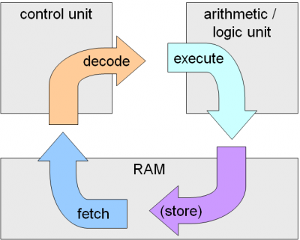
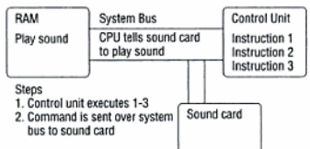
Machine Cycles

Slide 7
Memory
Memory is used to store large amounts of data. As CPU can only store basic instructions to operate.
Two Types Of Memory
Volatile - (RAM)
Non- Volatile - (ROM, PROM, EEPROM etc)

Slide 8
Types of Computer
Super computers : The super computers are the most high performing system. A supercomputer is a computer with a high level of performance compared to a general-purpose computer.
Mainframe computers : These are commonly called as big iron, they are usually used by big organisations for bulk data processing such as statics, census data processing, transaction processing and are widely used as the servers as these systems has a higher processing capability as compared to the other classes of computers
Mini computers : These computers came into the market in mid 1960s and were sold at a much cheaper price than the main frames, they were actually designed for control, instrumentation, human interaction, and communication switching as distinct from calculation and record keeping, later they became very popular for personal uses with evolution

Slide 9
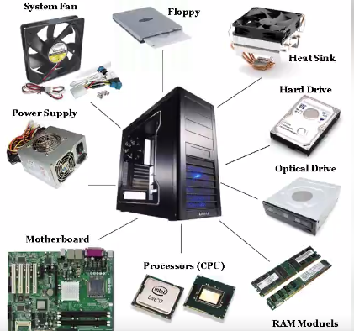
Parts of Computer

Slide 10
THE END

